Slide 1
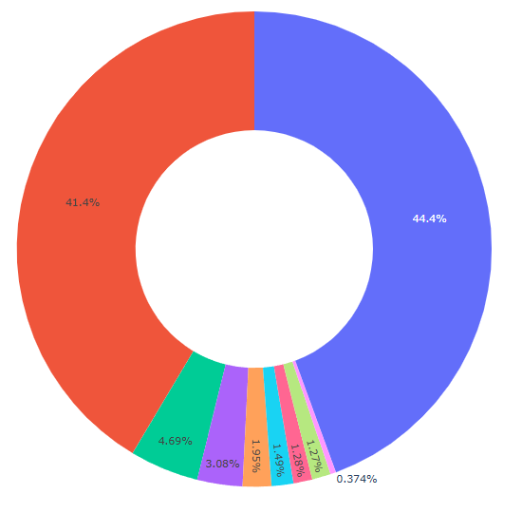
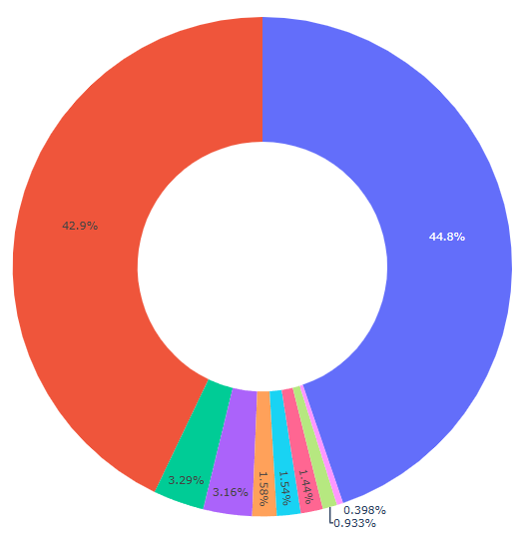
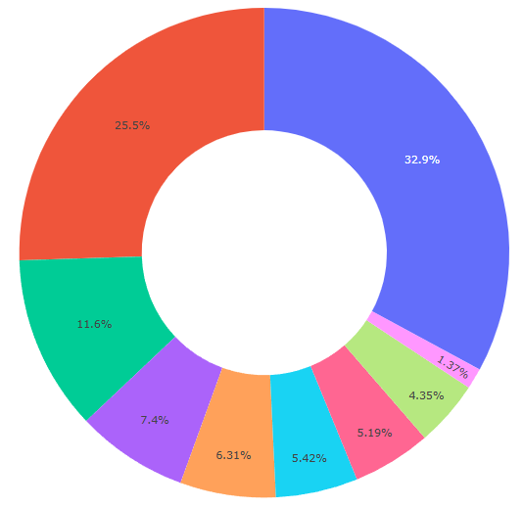

INITIAL CATEGORY WISE DISTRIBUTION
Category in terms of Production
Category in terms of Area
Category in terms of Yield

Slide 2
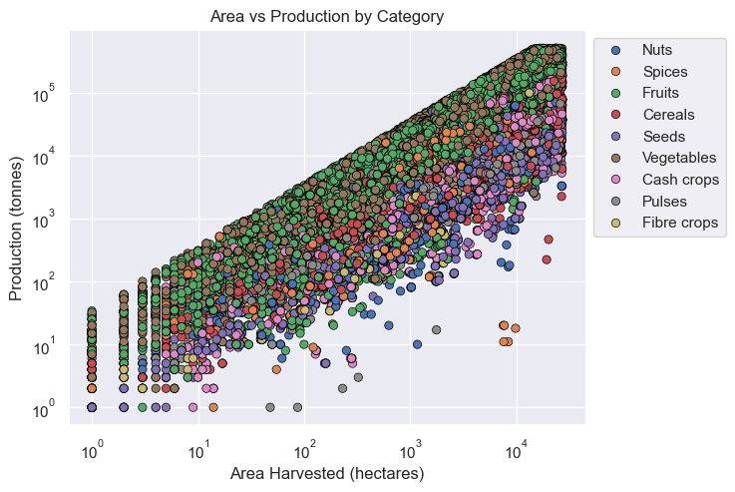
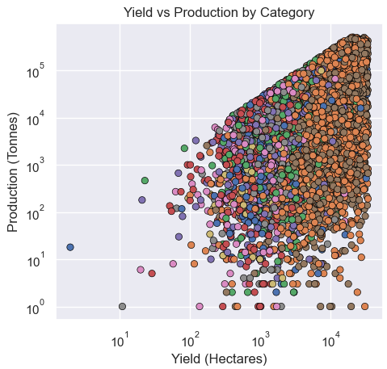
PATTERN BETWEEN PRODUCTION, AREA HARVESTED & YIELD

Slide 3
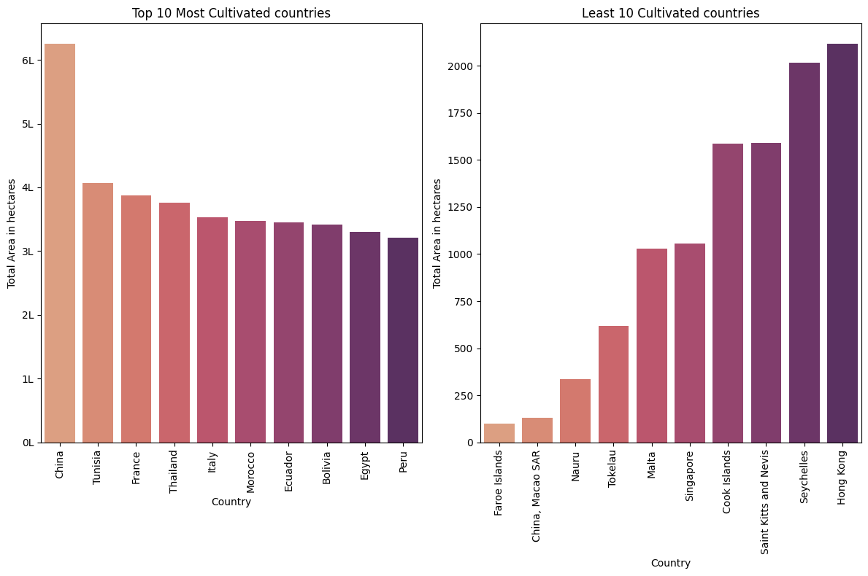
COUNTRY INTERMS OF AREA HARVESTED

Slide 4
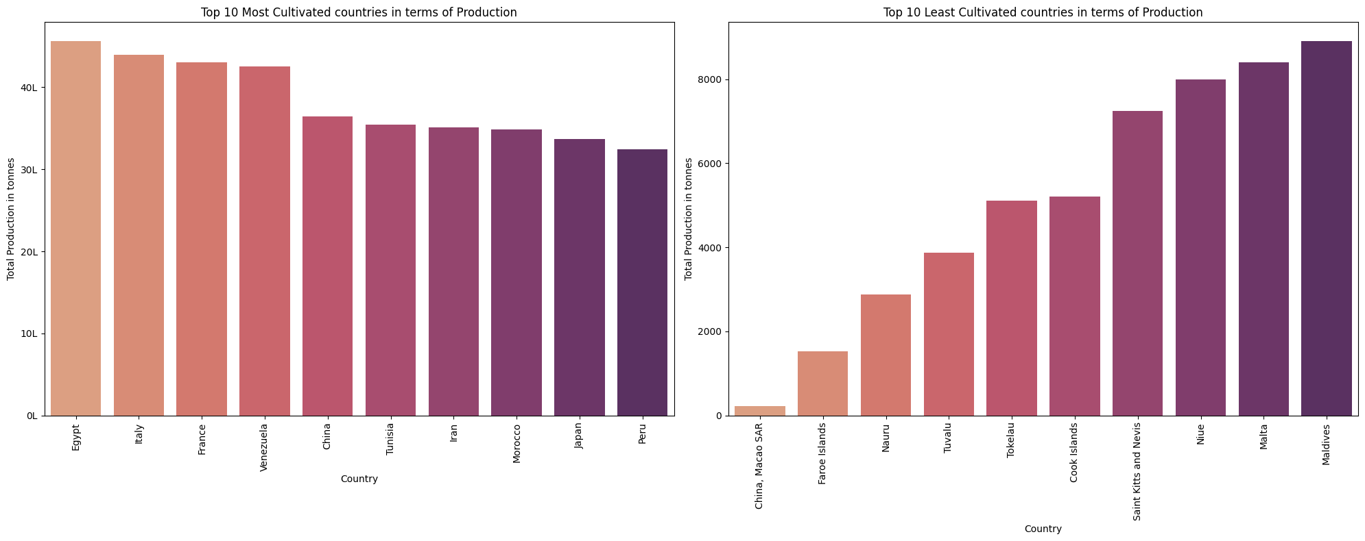
COUNTRY INTERMS OF PRODUCTION

Slide 5
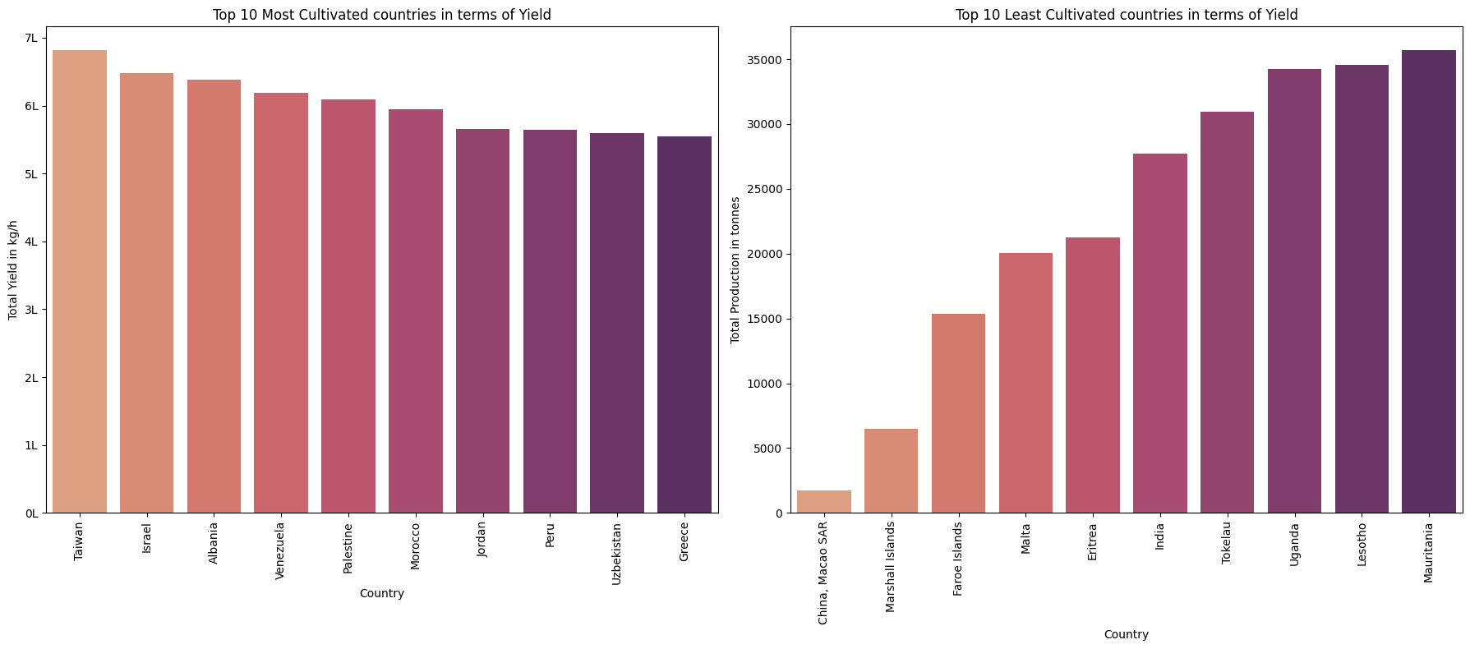
COUNTRY INTERMS OF YIELD

Slide 6
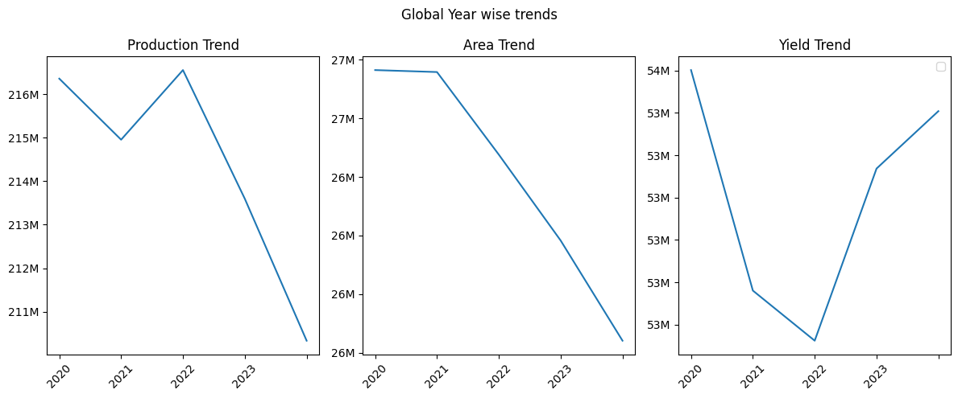
GLOBAL YEAR TREND

Slide 7
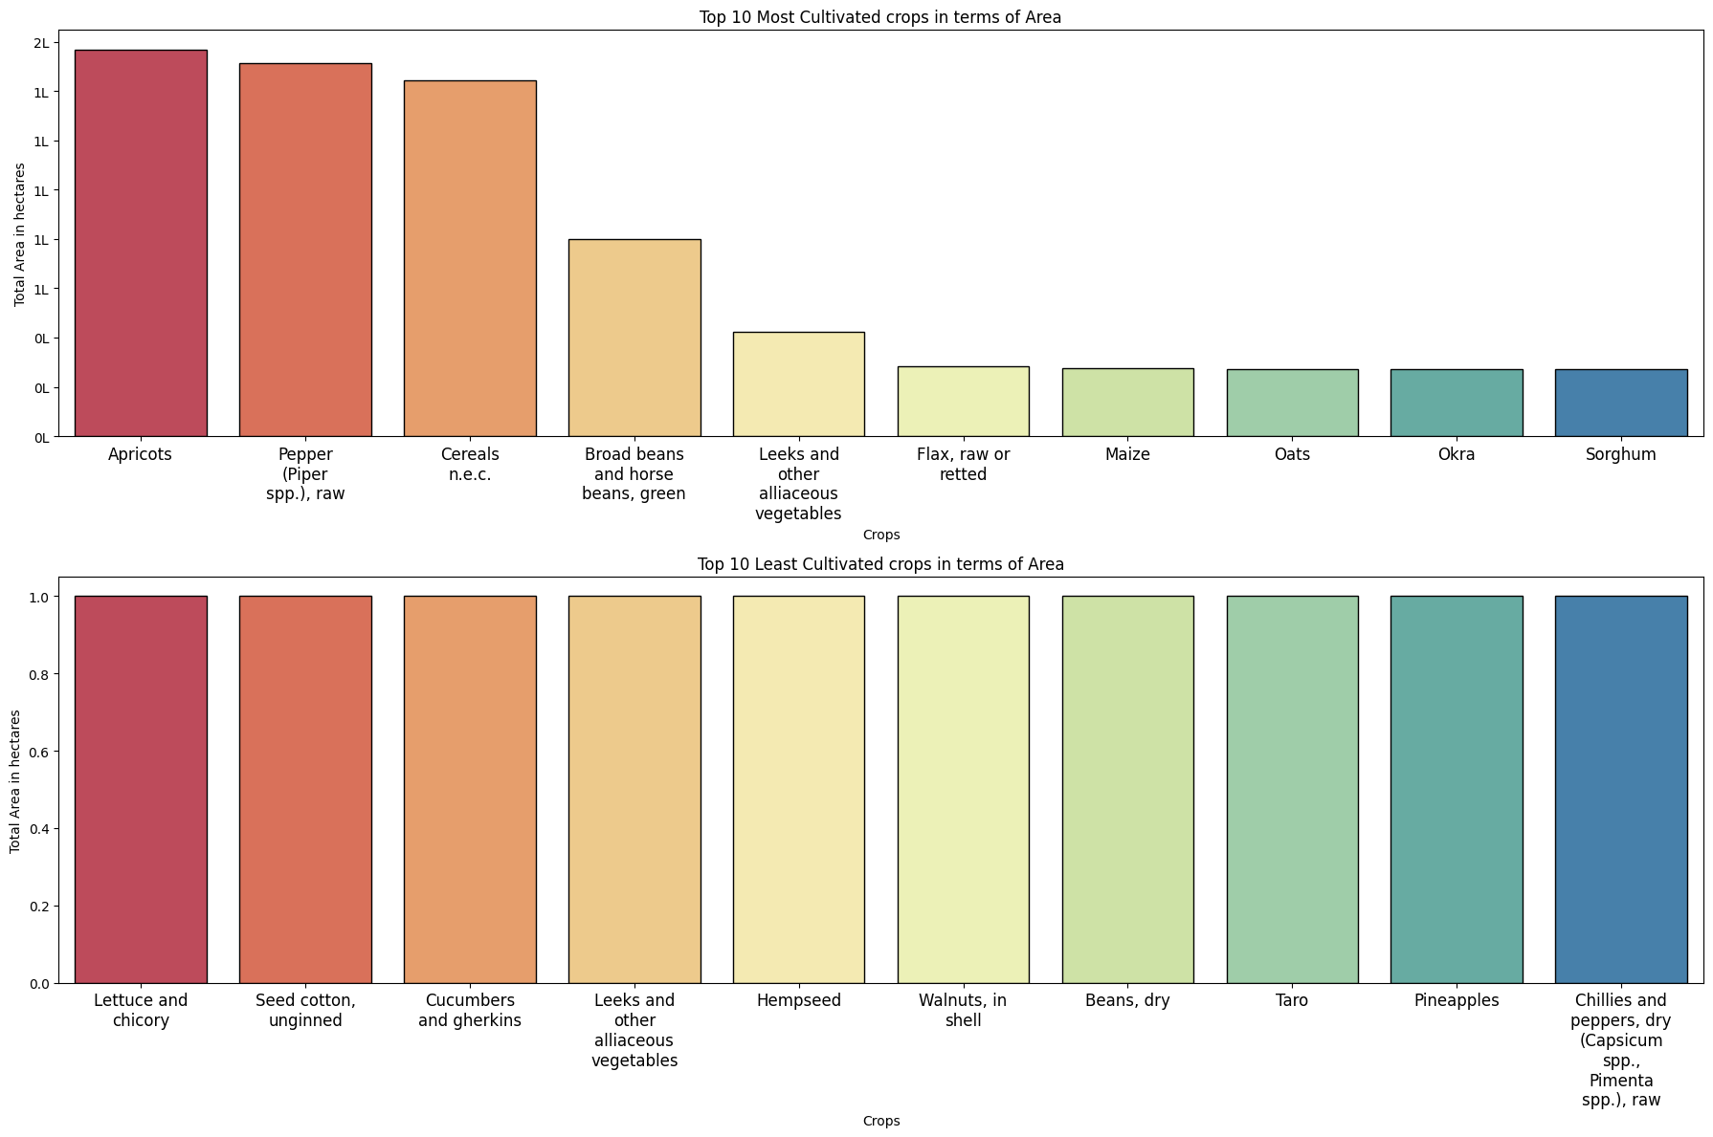
CROP CULTIVATED INTERMS OF AREA

Slide 8
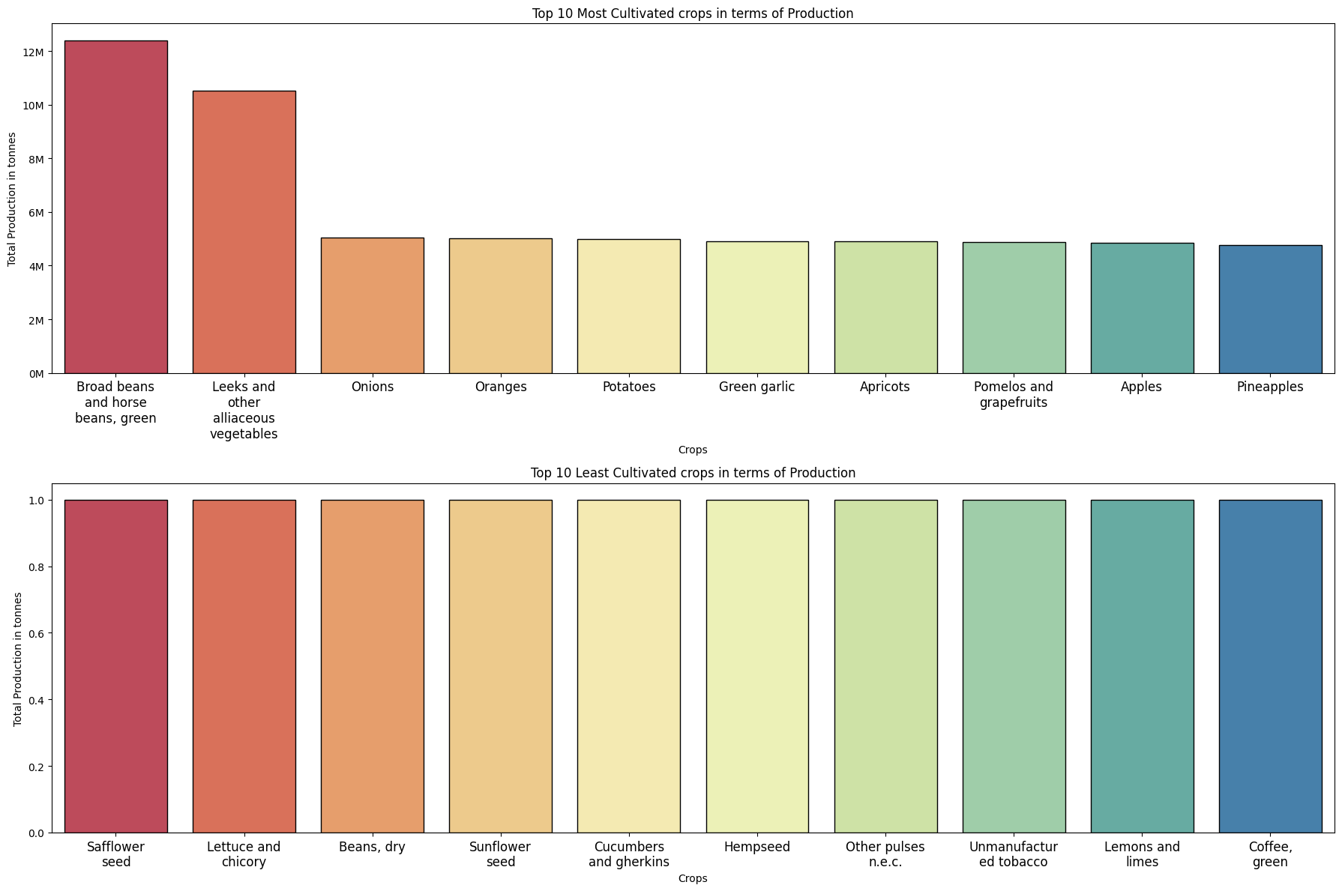
CROP CULTIVATED INTERMS OF PRODUCTION

Slide 9
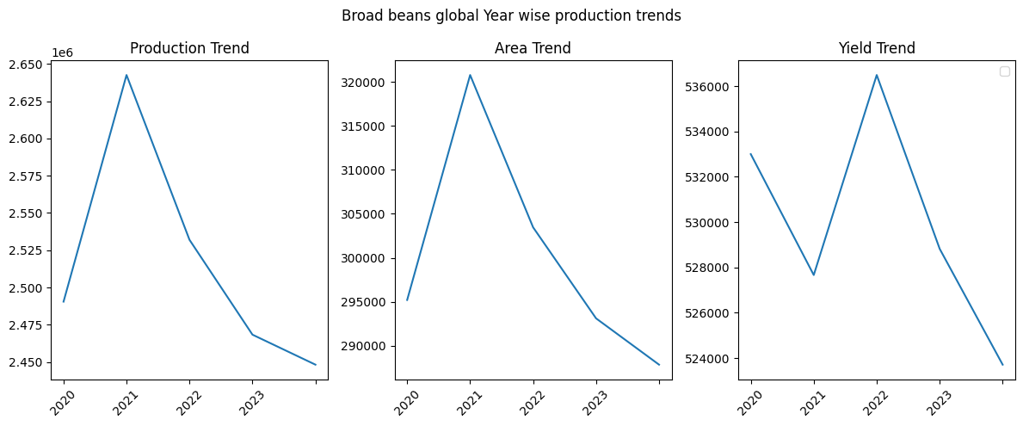
CROP (BROAD BEANS) CULTIVATED INTERMS OF PRODUCTION - GLOBAL TREND

Slide 10
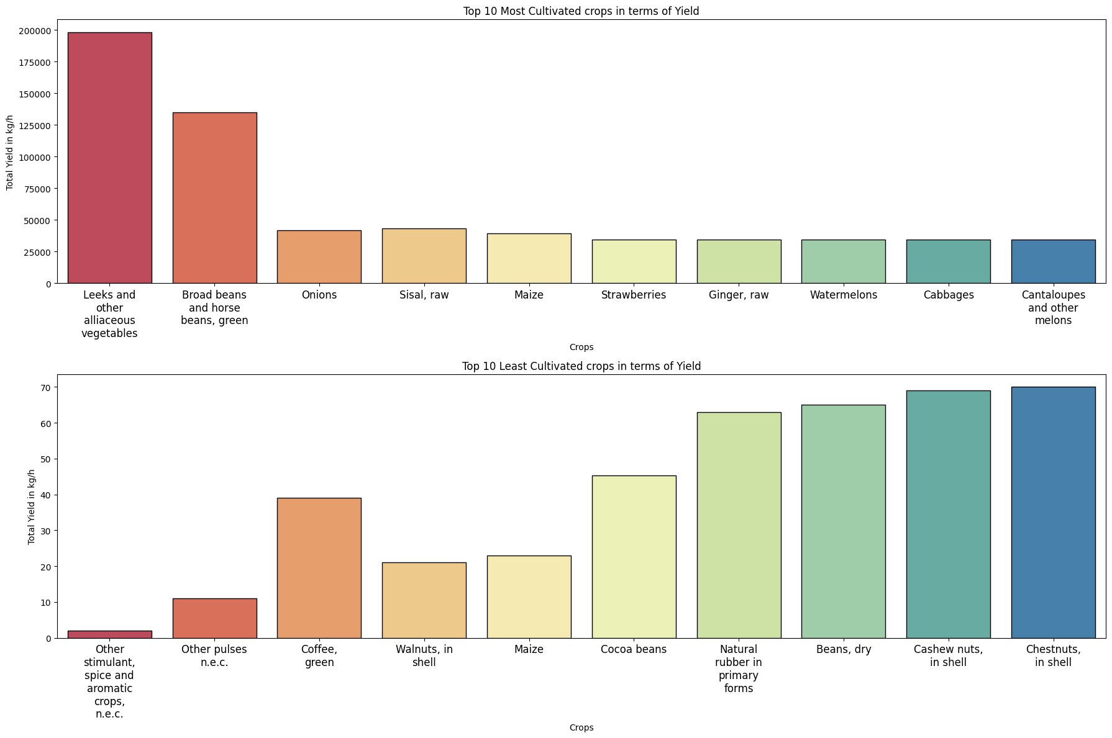
CROP CULTIVATED INTERMS OF YIELD

Slide 11
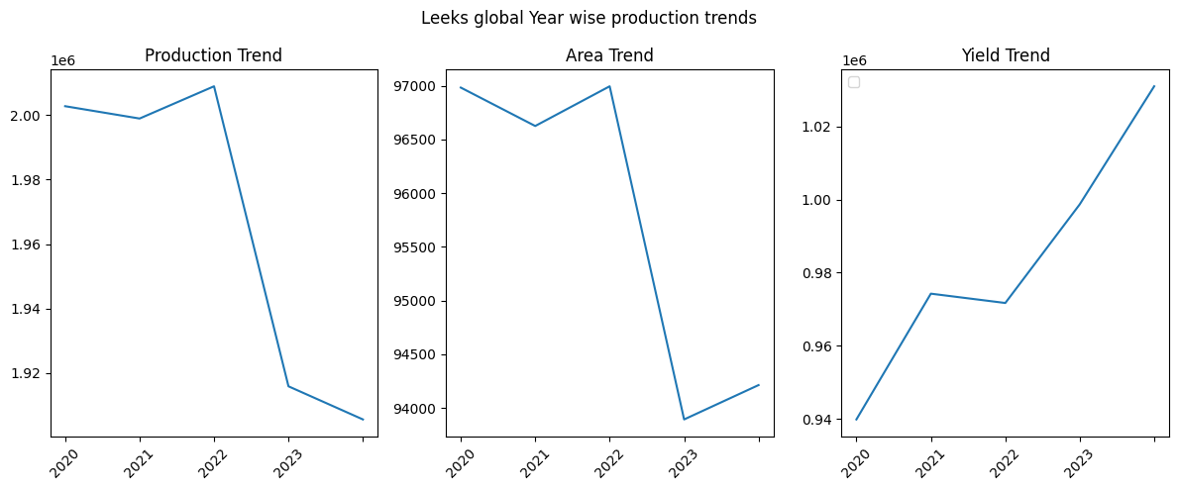
CROP (LEEKS) CULTIVATED INTERMS OF YIELD – GLOBAL TREND

